Slide 1


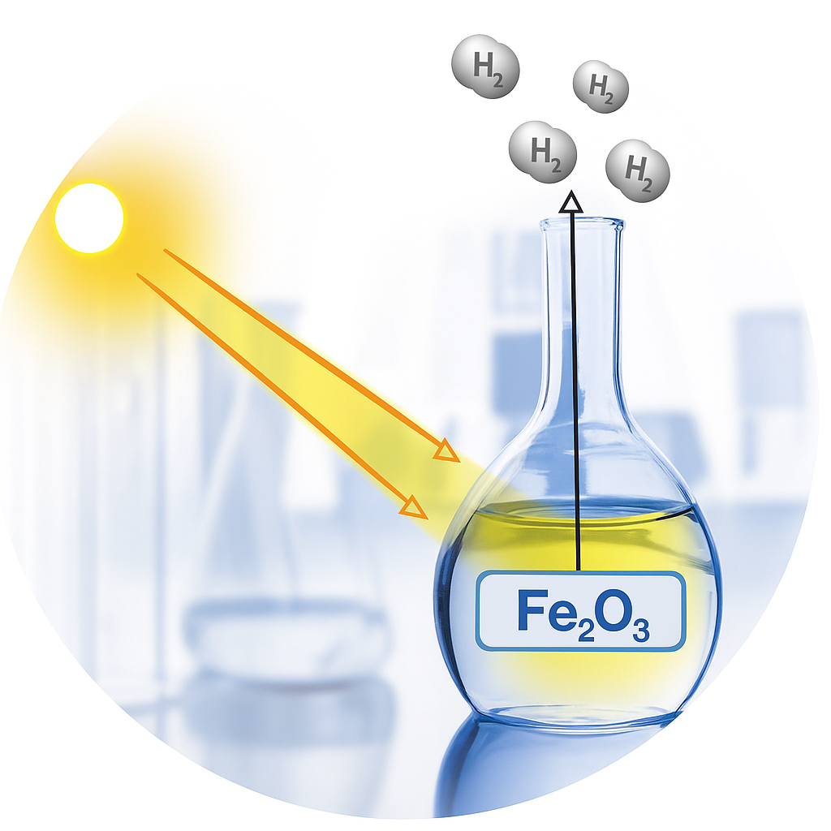

Computational Design of Photocatalytic Materials for Solar Energy Conversion: A Case Study on Exciton Dynamics and Electronic Structure in Hematite
Computational Design of Photocatalytic Materials for Solar Energy Conversion:
A Case Study on Electronic Structure and Early-Time Dynamics of Exciton in Hematite
By
Lili Rassouli
Under supervision of
Prof. Dupuis
May 2021
PhD Dissertation Defense by
Lili Rassouli
Supervised by
Prof. Michel Dupuis
July 28, 2025
Chemical and Biological Engineering
University at Buffalo
State University of New York
1

Slide 2





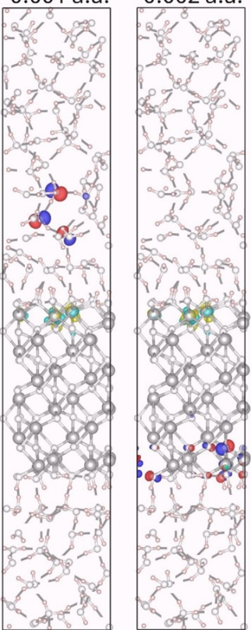
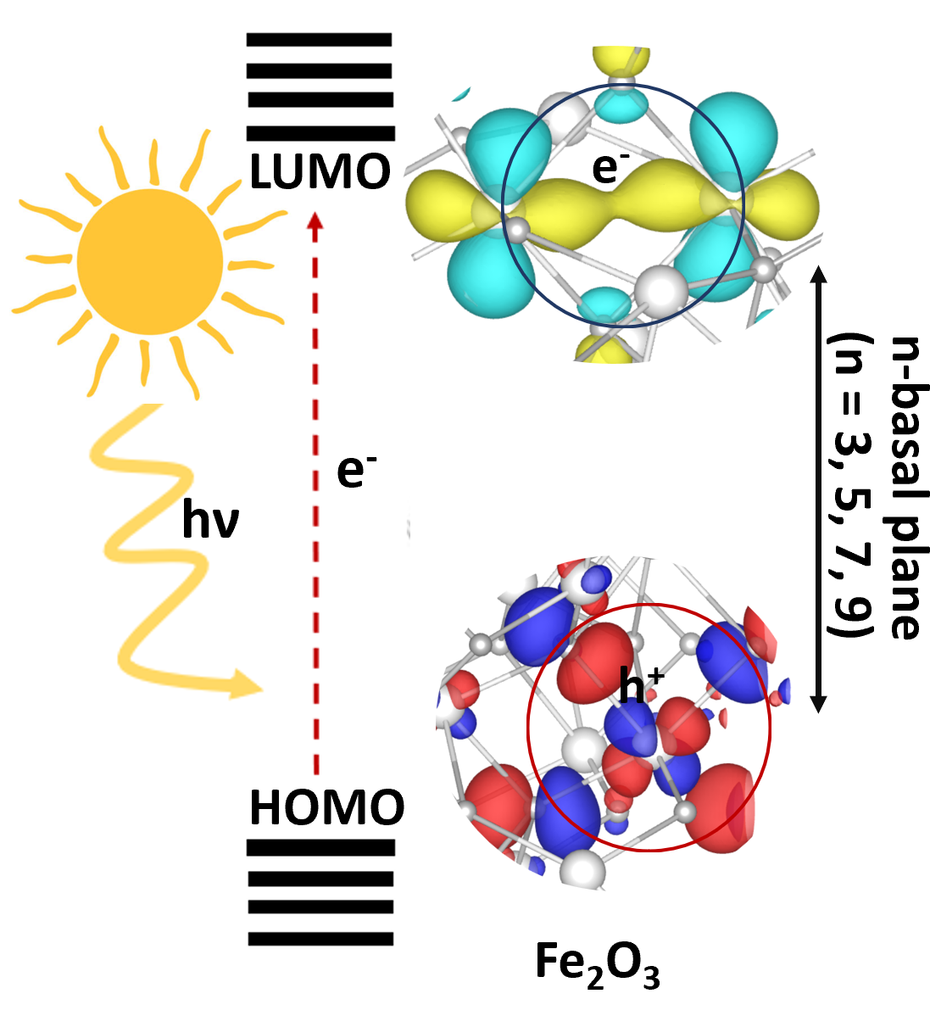
2/31
Introduction
Methods
Outlook
Results I
Conclusion I
Results II
Conclusion II
Exciton structure in hematite-water slab
Exciton structure and dynamics in bulk of hematite
DFT
TD-DFT AIMD
MM-MD
NA-MD
Science Theme
Objective Experimental Results Computational Results

Slide 3
Introduction

Slide 4
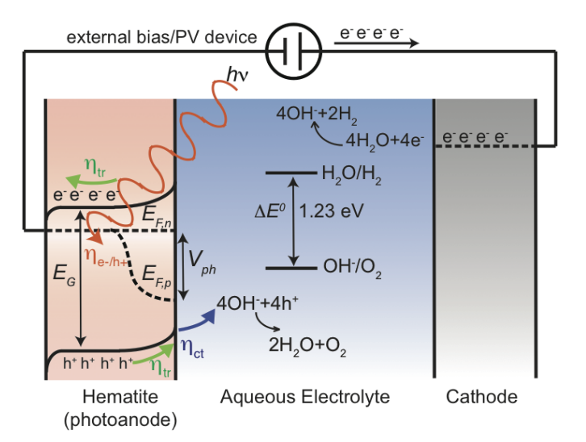
4/31
Solar Energy and Photoelectrochemical Water Splitting
Environmental problems → turn to green energies¹
e⁻
hv > Eg
Convert solar energy to fuels →
using photoelectrochemical (PEC) cell ²
HER
e⁻
The mechanism of PEC:³
(1) light absorption and charge carrier generation
(2) charge transport
(3) redox reactivity
e⁻
h⁺
h⁺
OER
Our work applies computational methods to study charge generation, exciton structure, and early-time dynamics in hematite.
Photoanode
Photocathode
The schematic diagram of photoelectrochemical reaction.⁴
[1] Grätzel, M. Nature, 2001, 414, 338–344.
[3] Yang, J. et al. Acc. Chem. Res. 2013, 46, 1900-1909.
[4] Van de Krol, R. Et al. Springer, 2012.
[2] Gratzel, M. Trans. Royal Soc. A. 2007, 365, 993-1005.

Slide 5
5/31
Objective of This Research
Cross-validating state-of-the-art theories with experiments using directly comparable data
Exciton radius ≈ one metal–oxygen (M–O) bond length
Vibrational signatures of holes and electrons
Relaxation time: femtosecond (fs) range
Recombination time: picosecond (ps) range
Applying advanced computational methodologies to novel materials to aid the discovery of efficient water-splitting photocatalysts
Our contributions — for the first time in Hematite:
Studied excitons as bound electron–hole pairs
Quantified the exciton radius
Captured the early-time dynamics of excitons
Performed separate vibrational analyses for electrons and holes
Extended the study from bulk to more realistic interface systems
Methods:
DFT+U, TD-DFT, and Non-Adiabatic Molecular Dynamics (NA-MD)
applied to both bulk and surface models of hematite as a case study

Slide 6
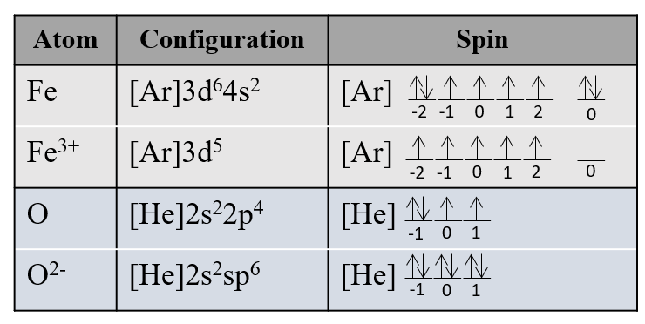
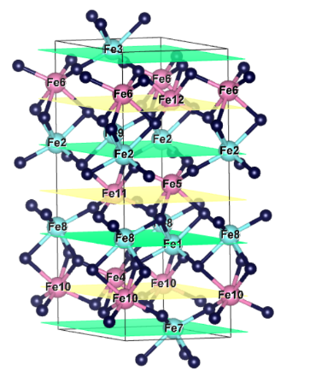
6/31
Hematite (Fe₂O₃), Excellent Test Bed for Validating Advanced Computational Methods
✔ Benefits: Desirable Properties¹ • Abundant and stable in aqueous environments • High visible-light absorption (bandgap ≈ 2.1 eV) • High theoretical solar-to-hydrogen efficiency (~16.8%)²
✔Challenges: Known Limitations³ • High electron–hole recombination rate • Low charge carrier mobility
• Very short hole diffusion length (2–4 nm)
✔ Simulation Value: Ideal Candidate
• Extensive experimental data to validate results
• Strongly correlated system: Fe³⁺ (3d⁵ high spin)
• Layered antiferromagnetic structure
Hematite offers a well-characterized, complex model system to evaluate advanced DFT+U and TD-DFT methods for photoelectrochemical applications.
[1] Sivula, K. et al. Chemsuschem 2011, 4, 432-449
[2] Murphy, A. B. et al. Int. J. Hydrog. Energy. 2006, 31, 1999-2017.
[3] Zandi, O. et al. Phys. Chem. Chem. Phys. 2015, 17, 22485-22503.

Slide 7
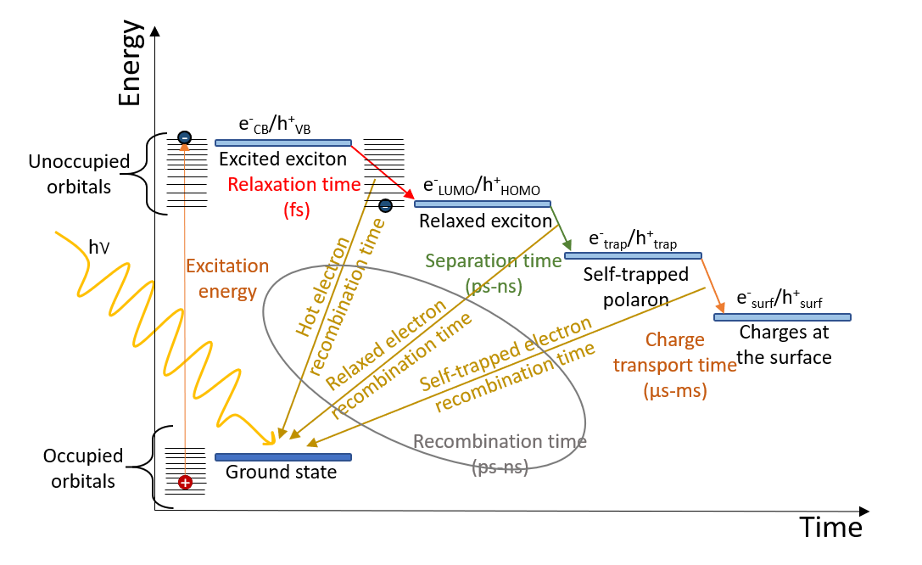
7/31
Experimental Studies on Hematite
Main Mechanism: Predominantly O 2p → Fe 3d transitions (supported by most studies).^{1,2}
Exciton Size: Low-energy exciton radius ≈ one M–O bond.²
Electronic Structure
In bulk of hematite
Commonly Reported Timescales for Charge Carrier Dynamics³
Vibrational signatures of polarons
~640 cm⁻¹: electron polaron vibration⁴
~225 cm⁻¹: hole polaron vibration⁵
Dynamics in bulk of hematite
Our simulations predicted hole polaron vibration ahead of experimental discovery.
Hematite-water Interfaces
Studies focus on the surface atomic structure of hematite in water.
The full interface, including water structure and dynamics, remains poorly understood.
[1] Carneiro, L. M. et al. Nat. Mater 2017, 16, 819-826.
[3] Corby, S. et al. Nat. Rev. Mater. 2021, 6, 1136-1155.
[5] Johnston, C. R. et al. Submitted to JACS.
[2] Biswas, S. et al. Chem. Commun. 2018, 54, 4216-4230.
[4] Šuligoj, A. et al. J. Phys. Chem. C 2021, 125, 28013-28024.

Slide 8
8/31
Addressing Key Gaps Beyond Previous Computational Work
We describe excitons as bound electron–hole pairs for the first time.
Prior work studied:
Light absorption is dominated by O 2p → Fe 3d transitions¹ — consistent with our work.
Electron polarons are delocalized over two Fe centers² — our exciton electron shows the same localization
Hole polarons are localized on Fe with some O involvement² — our exciton hole localizes differently, revealing a distinct structure
We quantify the exciton radius, connecting it to Baker’s experimental results.
Exciton radius quantified in agreement with experiment — We go beyond, offering new insight into exciton behavior.
We capture early-time dynamics and vibrational signatures.
Prior studies estimated recombination time in ps order³ — same trend, factor of 10 longer.
No previous computational study calculated relaxation time in hematite.
No previous computational study resolved vibrational dynamics of electron and hole separately.
We extend exciton analysis to the hematite–water interface for the first time.
Hydroxylated surface has the lowest surface energy⁴ — our work builds on this termination.
Slab model is used to study interfacial structure and hydrogen bond dynamics⁵ — We build on these models and further expand them.
No prior computational study analyzed excitations at the hematite–water interface
[1] Xia, C. et al. Phys. Lett. A 2013, 377, 1943-1947.
[3] Cheng, C. et al. NPJ Comput. Mater. 2022, 8, 148.
[5] Von Rudorff, G. F. et al. J. Phys. Chem. Lett. 2016, 7, 1155-1160.
[2] Ahart, C. S. et al. Phys Chem Chem Phys 2020, 22, 10699-10709.
[4] Ferrer M M. et al. Model. Simul. Mater. Sci. Eng. 2016, 24, 025007

Slide 9
Methods

Slide 10
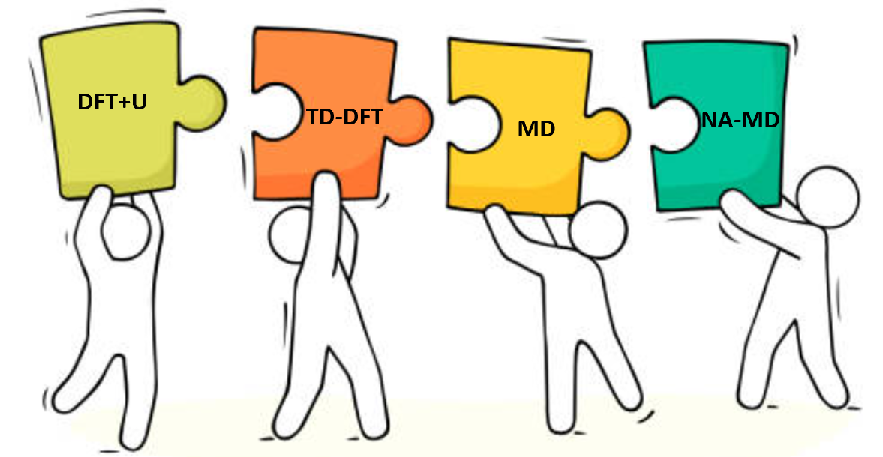
10/31
Key Aspects of Computational Methods
Bulk of hematite
Hematite-water slab
Cell Optimization (Ground-State DFT+U): • Periodic DFT with Hubbard +U corrections using CP2K
• Spin-polarized Unrestricted Kohn-Sham (UKS)
• Mulliken population analysis using Multiwfn • +U Parameters based on gap-optimized approach: Fe: +U = 3.0 eV, O: +U = 2.0 eV • Brillouin Zone Sampling: Γ-point; band gap convergence studied using Quantum Espresso • Supercells: 2×2×1 and 2×2×3 for hematite bulk, 2×2×1 or 2×2×3 slabs with 33 Å or 66 Å water layers • Geometry Optimization: Reproduced hematite’s antiferromagnetic structure with optimized lattice constants and Fe–O bond lengths matching experiment
Cell Optimization
DFT
water box
MD
MM-TIP3P
AIMD
hematite-water
MD
MM-FlxSPC-ClayFF
Molecular Dynamics (AIMD & Classical MD):
• NVT-AIMD (DFT+U) for bulk hematite
• Classical MD with TIP3P for water box • Classical MD with FlxSPC–ClayFF for hematite-water slab
Single point
TD-DFT
hematite-water
Geo-opt
DFT
Electronic Structure (Periodic DFT & TD-DFT):
• Linear-response TD-DFT using CP2K • Excited-state optimizations for 2×2×1 and 2×2×3 supercells
NA-MD
hematite-water
AIMD
Non-Adiabatic Dynamics (NA-MD): • Using CP2K + LIBRA¹ for time-overlap and nonadiabatic couplings (NAC) calculations • Doing stochastic surface hopping for recombination & relaxation on the many-body basis
hematite-water
Single point TD-DFT
Vibrational Analysis: • Generalized Subsystem Vibrational Analysis (GSVA) for electron-hole vibrational modes • Vibrational analysis along selected reaction coordinates to characterize lattice distortions
[1] Akimov, A. V. J. Comput. Chem. 2016, 37, 1626-1649.

Slide 11
Results I
Exciton in the Bulk of Hematite

Slide 12
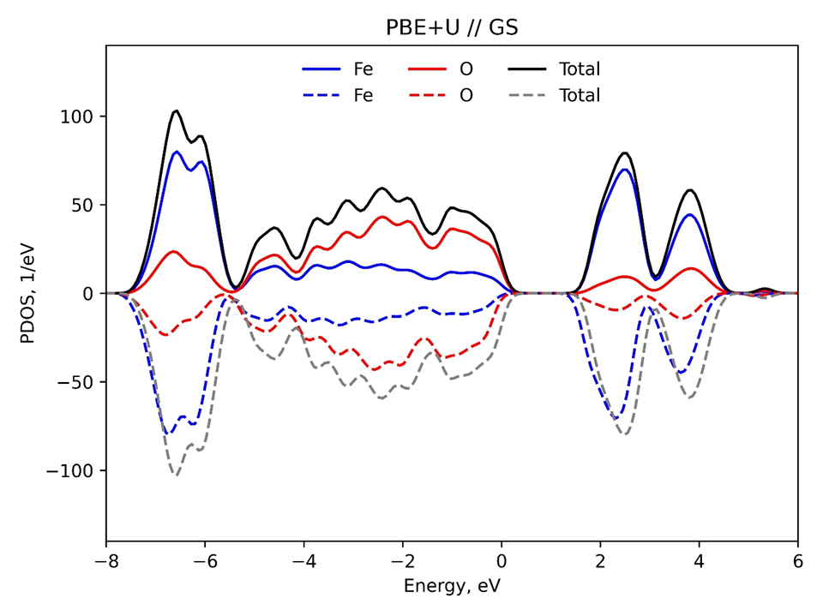
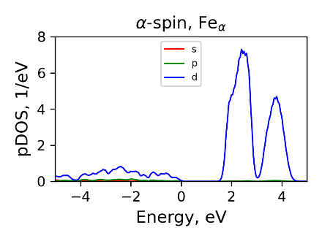
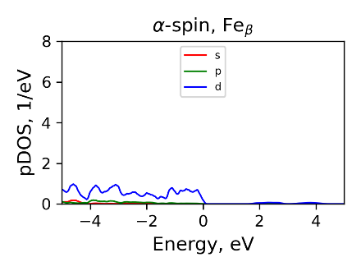
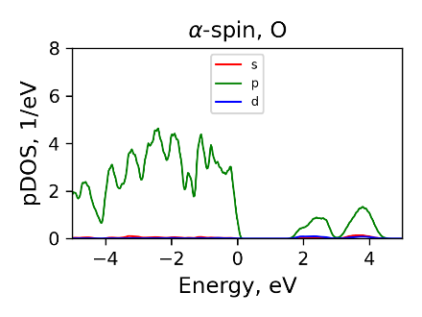
12/31
Ground State: Projected Density of States
O 2p → Fe 3d transitions
α spin orbitals projection
Strong contribution from Fe in the α-plane (5 α-electrons) to the d-orbital of the conduction band.
Excitation Process:
an α electron from the top of valence bend with O 2p character is excited into the bottom of the conduction band on the Fe_{β} basal plane.
VB
CB
Mainly oxygen (O 2p) orbitals
No contribution from Fe in the β-plane (no α-electrons) to the conduction band.
Mainly Iron (Fe 3d) orbitals
Significant contribution from O p-orbitals to the valence band (VB).

Slide 13
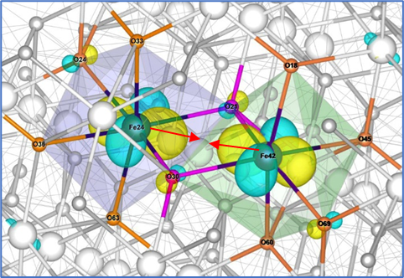
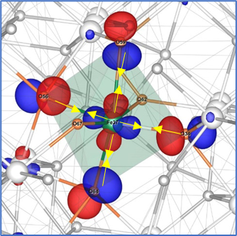
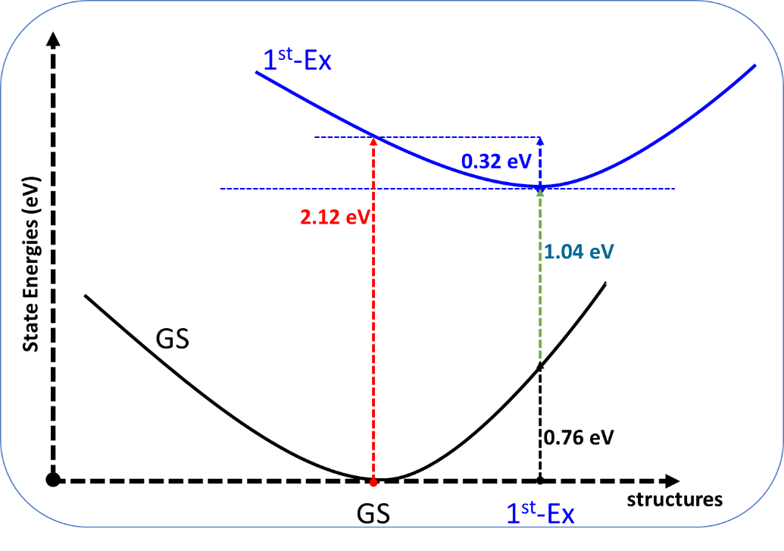
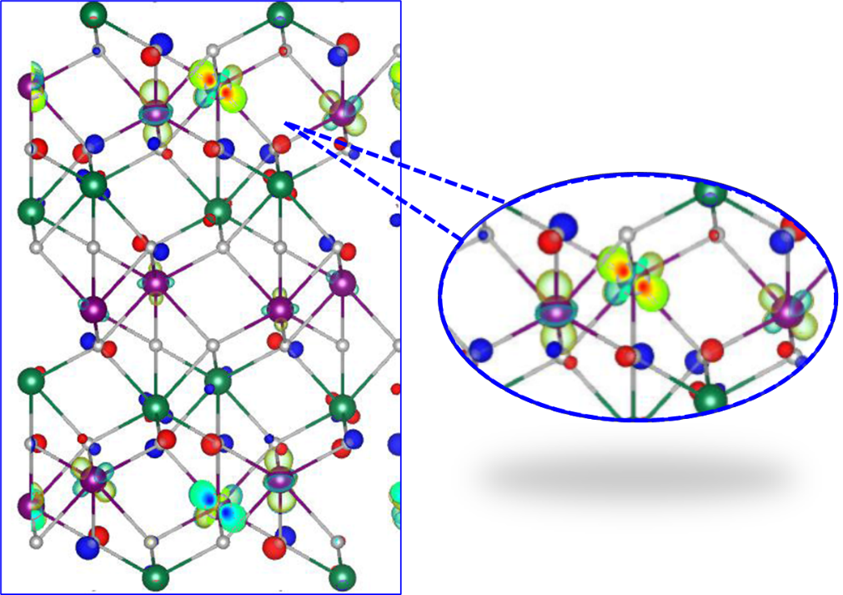
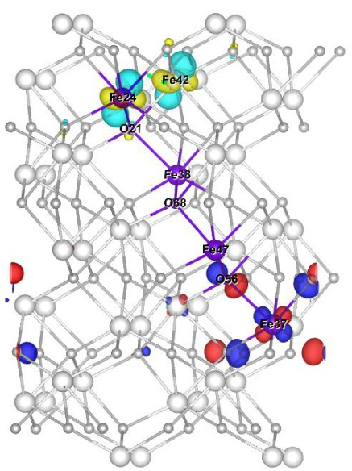
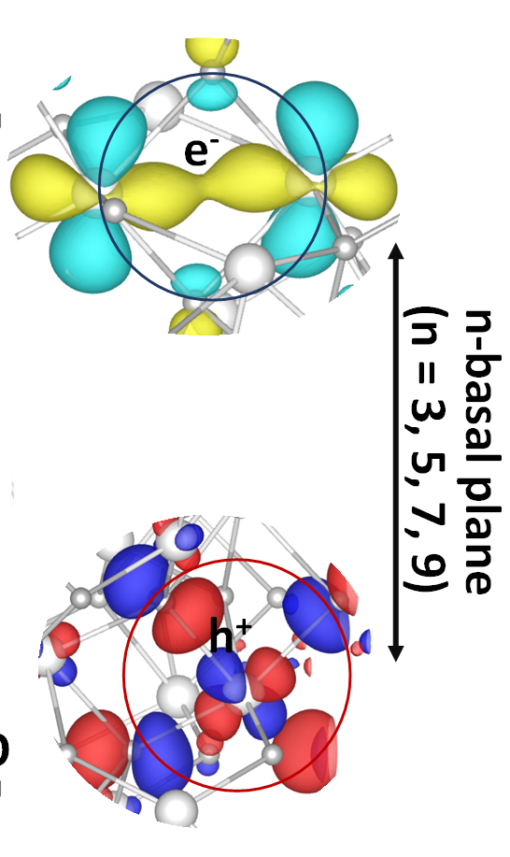
13/31
Characteristics of Low-lying Excited States at the GS and 1st-Ex Geometries
1st-Ex// GS
1st-Ex// 1st-Ex-geo
O
Fe
O
Fe
Fe
Fe
Fe
O
1st-Ex// GS
Fe
O
1st-Ex// 1st-Ex-geo
← Fe-O→
← Fe-O→
O
O
O
Electron site: in-phase Fe–Fe bonding interaction → Leads to Fe–Fe bond shortening
Fe
O
O
Hole site: out-of-phase Fe–O anti-bonding interaction → Leads to equatorial Fe–O bond shortening
Electron distributed within Fe row
Electron localization on two neighboring Fe atoms
No local minimum for 1st-Ex at GS geometry → Energy decreases smoothly along both steepest descent and Marcus paths
Vibrational analysis confirms Exc-3 minimum → All frequencies positive → true minimum on excited-state PES
Hole distributed within O row
Hole localization on oxygen atoms within a (FeO₆)⁺ moiety
Energies associated with exciton structure
Hole-related vibrational mode along Marcus path: → ~230.5 cm⁻¹ → Matches experimental hole phonon at ~225 ± 7 cm⁻¹
Exciton radius: one M-O
Exciton structure:
separated 6 M-O, 3 basal planes
Electron-related vibrational mode along gradient direction: → ~645 cm⁻¹ → Matches experimental electron phonon at ~640 cm⁻¹
Marcus path: X(λ) = (1-λ) X(GS) + λ X(Exc-3) λ = 0.0 to 1.0
Steepest descent path: X′=X_{GS}​−η∇_{X}​E_{1st-Ex}​(X_{GS}​)

Slide 14
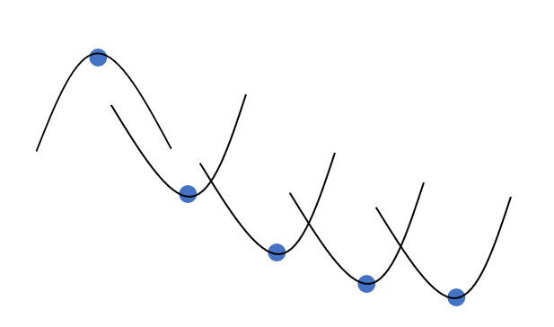
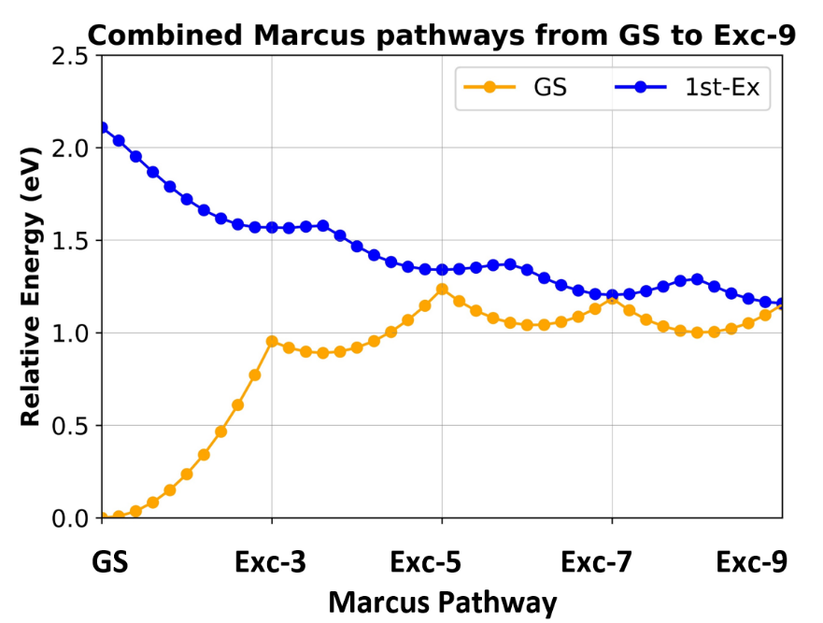

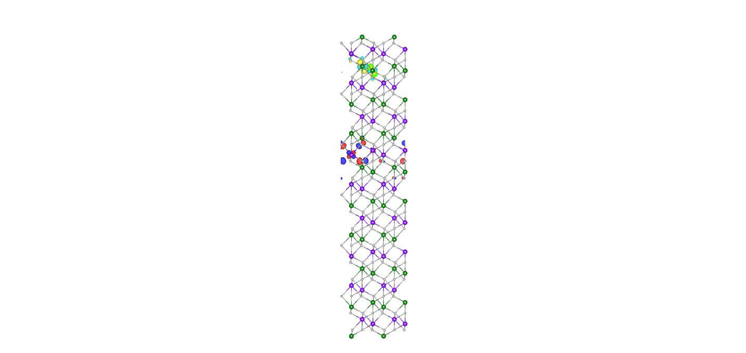
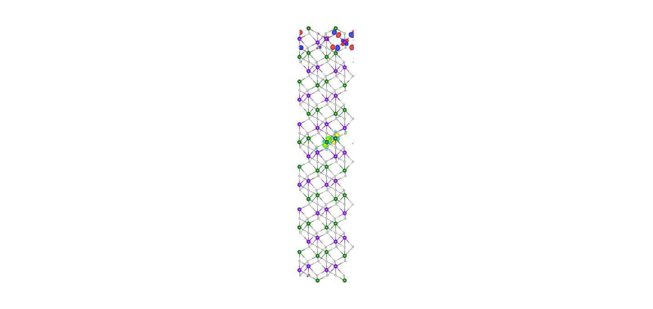
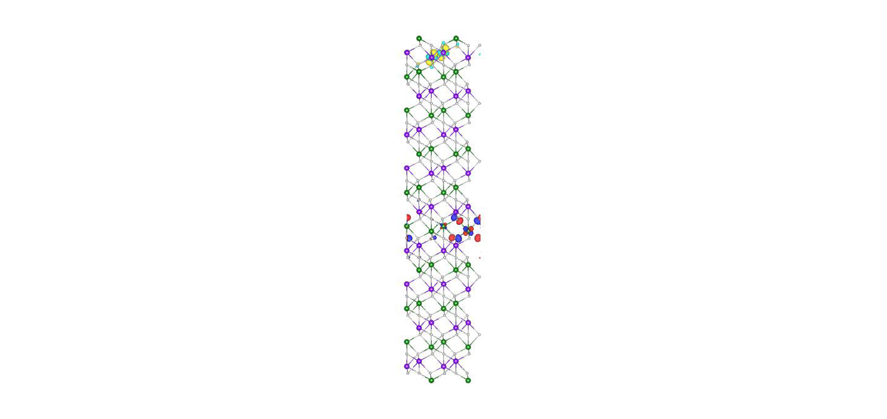
14/31
Polaron Formation
Exc-3 to Exc-9 states emerge as local minima as the electron–hole separation progressively increases.
Exc-1
Exc-3 is a true local minimum, not an artifact of the constrained 2×2×1 cell
HOMO and LUMO structures in 2×2×3 closely match those in 2×2×1
Exc-3
The hole's stepwise separation from the electron mirrors Marcus theory, with charge hopping between localized states forming lower-energy minima.
Exc-5
Exc-7
Exc-9
Orange curve : Distortion energy of the ground state along Marcus path.
Blue Curve: Hoping on excited-state energy profile along Marcus path.
Marcus path to define the hopping pathways:
X(λ) = (1-λ) X(Exc-i) + λ X(Exc-j) λ = 0.0 to 1.0

Slide 15
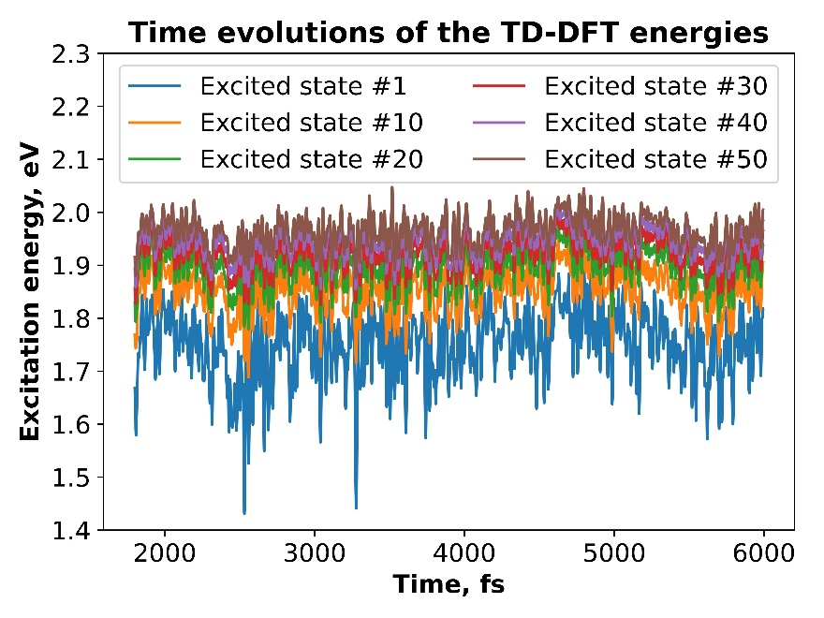
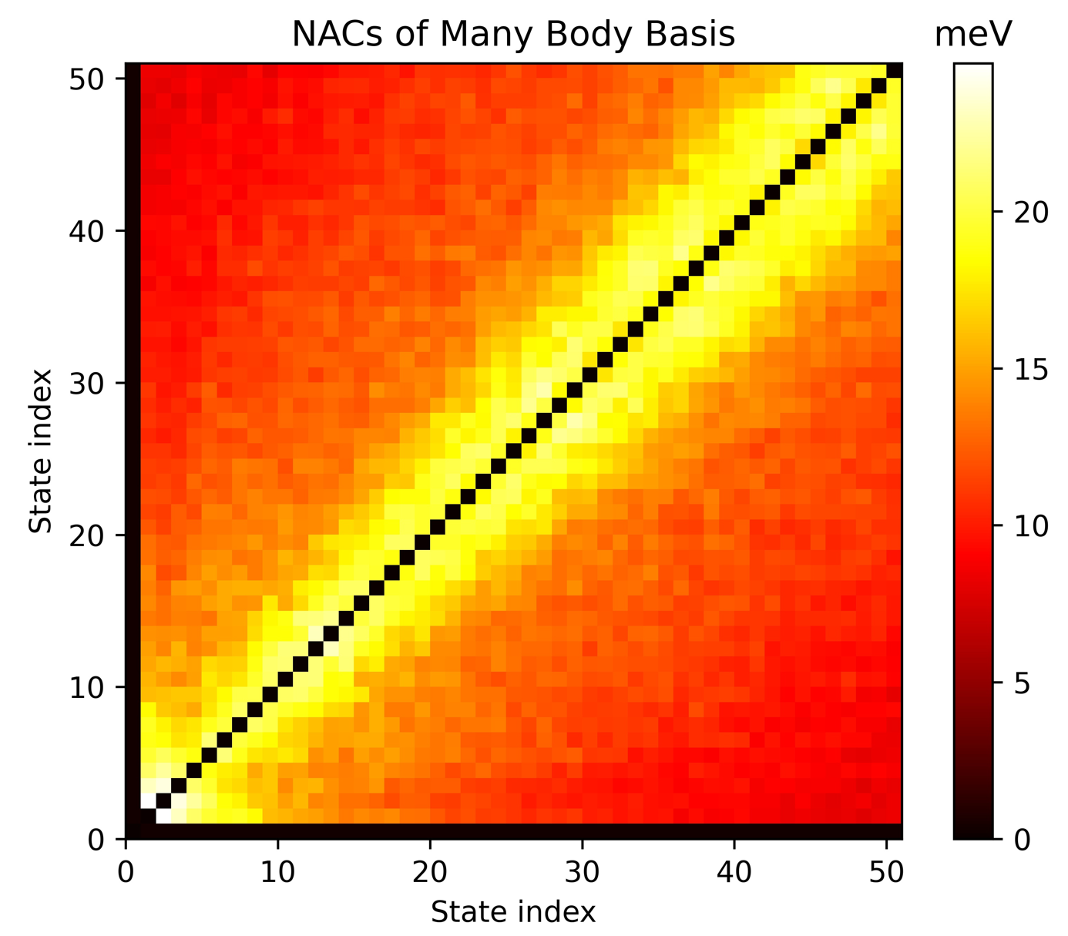
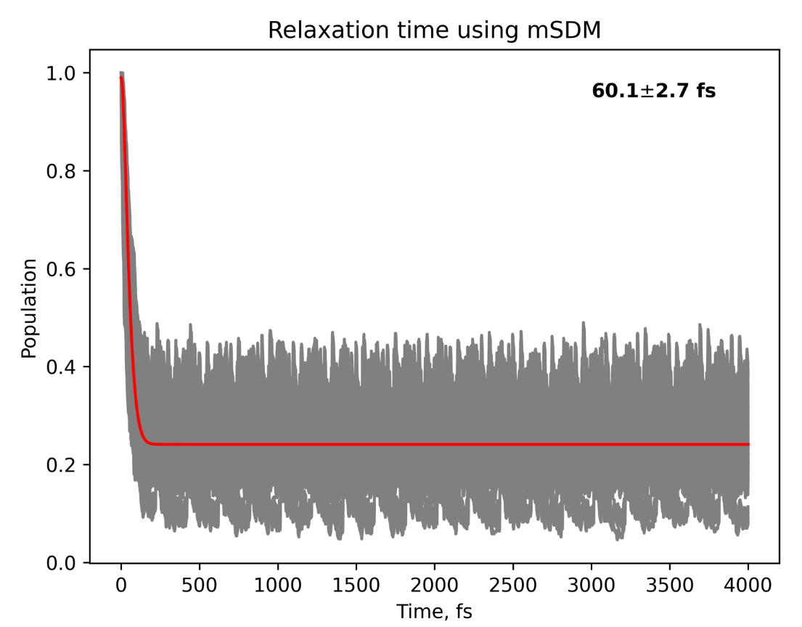
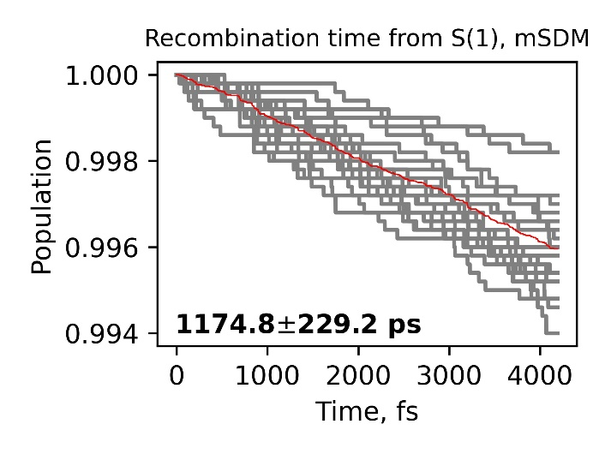
15/31
Short-Time Dynamics of Excitons
60 ± 3 fs
1175 ± 229 ps
Densely packed excited states with small energy gaps → large NACs among excited states, negligible NACs with ground state
MD trajectories do not reach the Exc-3 region; only photoexcitation accesses the 1st-Ex optimized geometry, as confirmed by bond length analysis and lack of sampling near the ~1.04 eV excitation energy
Recombination times from excited states are long (~1100–1800 ps) in both mSDM and ID-A approaches, with no clear dependence on initial state
Fast relaxation (~60–70 fs) across excited states in both mSDM and ID-A
Large NACs between excited states facilitate rapid interconversion, while small NACs with the ground state delay recombination and extend exciton lifetimes

Slide 16
Conclusion I
Exciton in the Bulk of Hematite

Slide 17

17/33
17/31
Conclusion I: Exciton in the Bulk of Hematite
O 2p → Fe 3d excitation matches experiment
Electron–hole separation radius matches experiment
Computed recombination and relaxation times match experiment
Computed electron/hole vibrations match experiment
Cross-validation of TD-DFT + NA-MD with experiments enables reliable evaluation of exciton behavior and methodology.

Slide 18
ResULTS II
Exciton in Hematite–Water Slab Systems

Slide 19

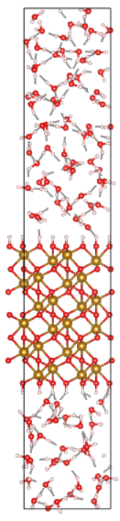
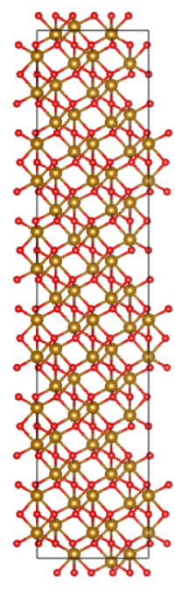
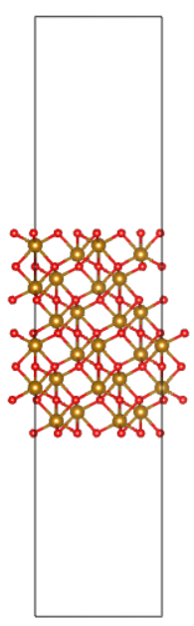

19/31
Computational Modeling of Hematite–Water Interfaces
Water Box MD – MM-TIP3P One snapshot is selected after equilibration
Hematite–Water MD – MM-FIxSPC–ClayFF One snapshot is selected after equilibration
Hematite–Water Geometry Optimization – DFT The optimized geometry is selected for MD-DFT
Hematite–Water MD – DFT
(a) (b) (c) (d) (e)
(a): 2× 2 × 3 supercell created from 2× 2 × 1 supercell
(b): 2× 2 × 1 supercell of hematite with an additional oxygen layer to create oxygen terminated slab
(c): protonating surface oxygens via H (proton) addition
(d): adding more vacuum
(e): adding equilibrated water box
Hematite–Water Single Point – TD-DFT TD-DFT calculation on each MD step

Slide 20
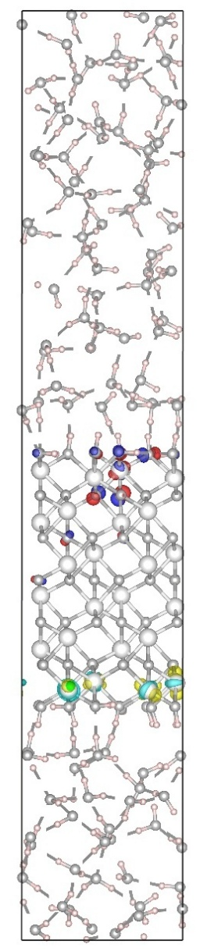
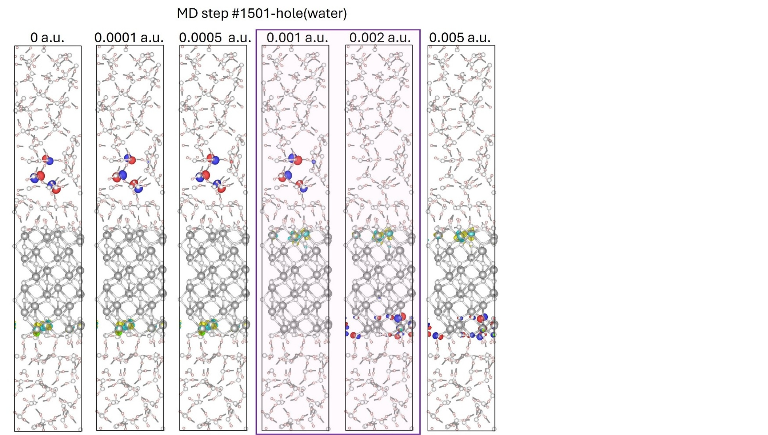
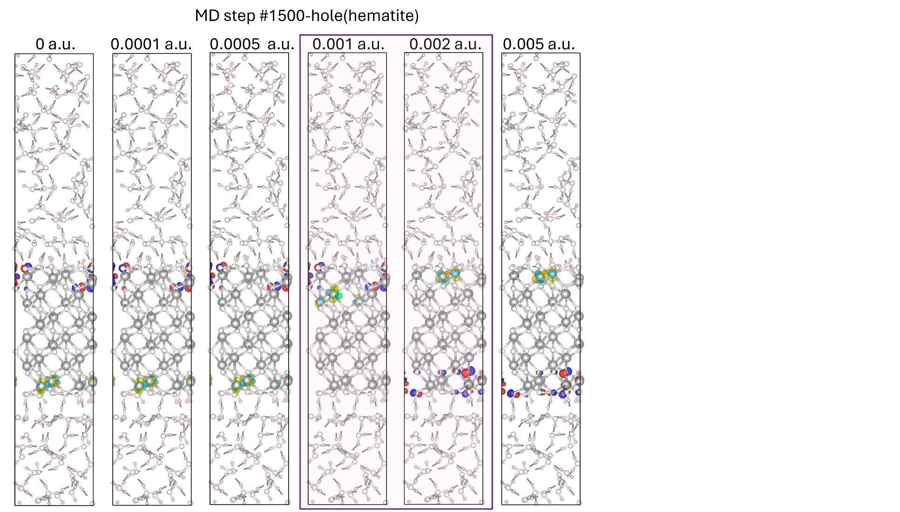
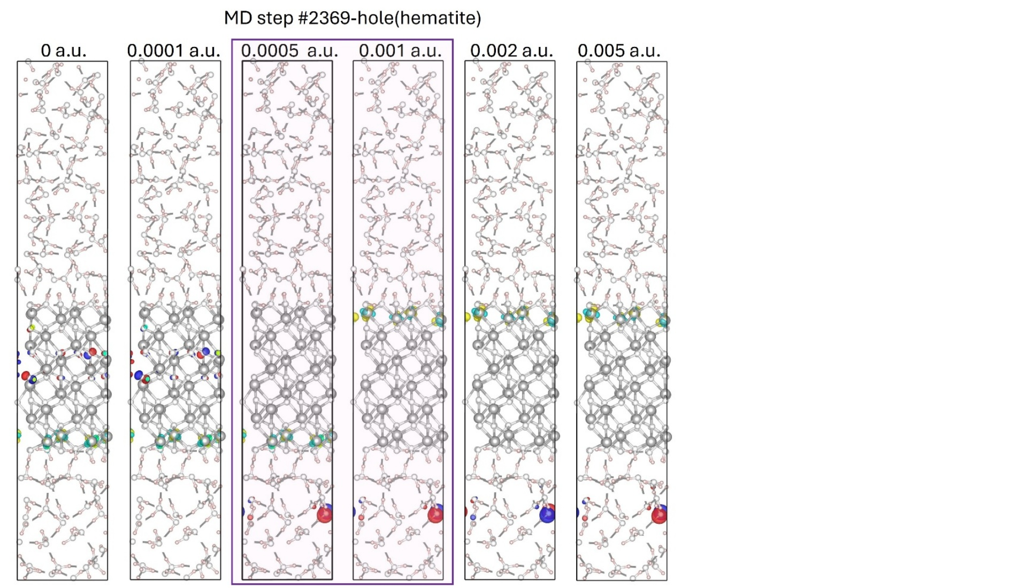
20/31
Characteristics of Low-lying Excited States at the GS and along the MD Trajectory
GS
Along the MD Trajectory
Exciton structure after vertical excitation (GS geometry):
Slab: Electron–hole pair separated across ~5 planes
Bulk: Unlocalized exciton with radius ≈ 1 Fe–O bond length
Along MD trajectory:
Hole localization varies:
Overall: O(hematite) (~71%) > O(water) (~23%)
Electron consistently localizes on Fe atoms in hematite
Filtering for oscillator strength > 1×10⁻⁶ :
Increases hole localization on hematite (~91%)
Reduces hole localization on water (~1%)
Water-localized holes are linked to weaker, less optically active excitations, making them difficult to detect against experimental noise.
Hole: (water)
(surface-hematite)
(bulk-hematite)

Slide 21
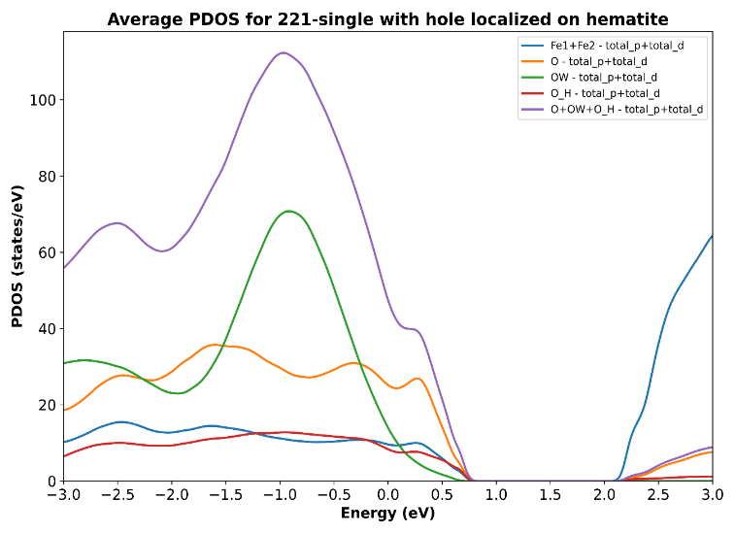
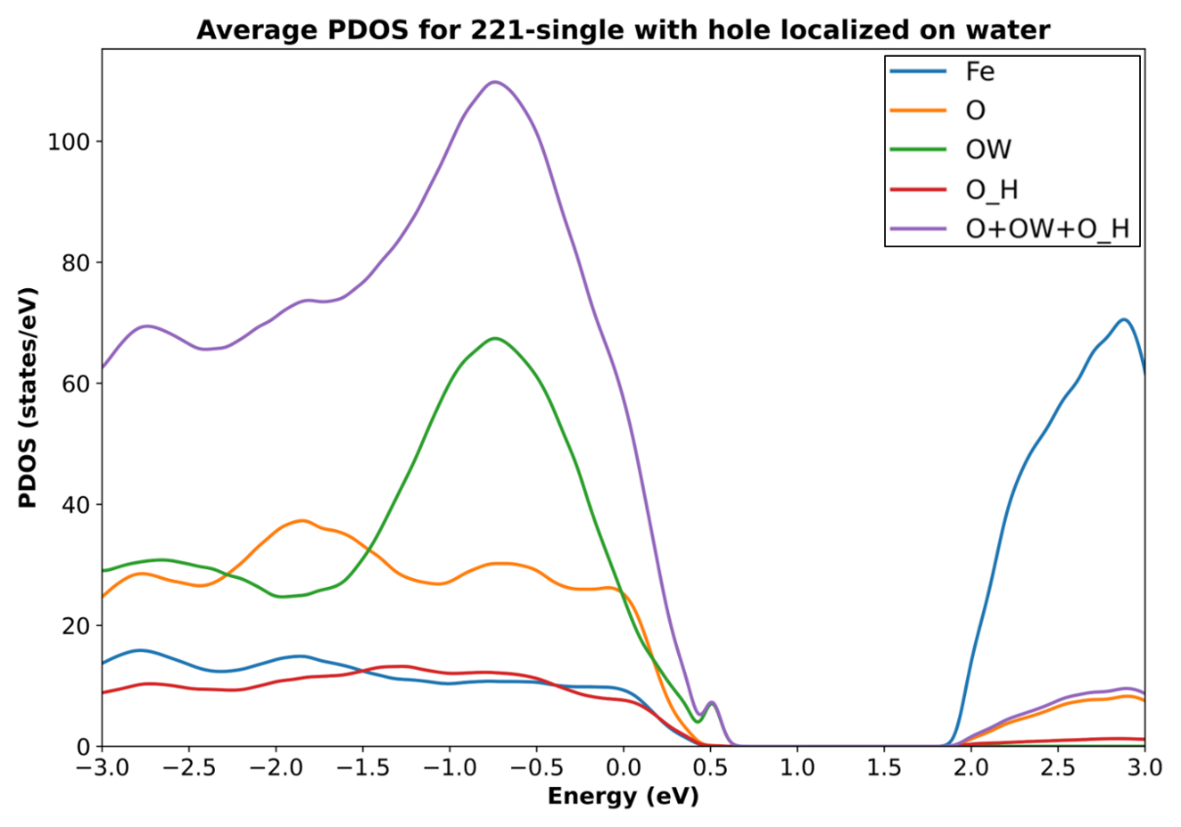
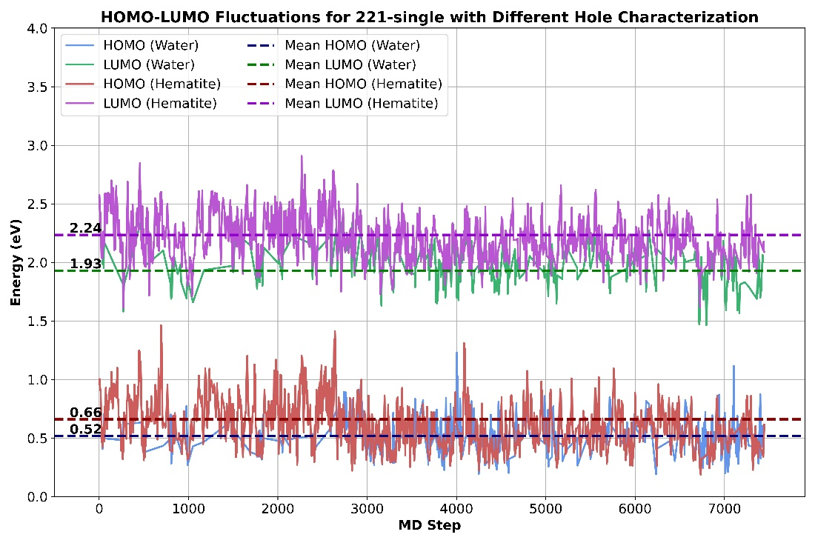
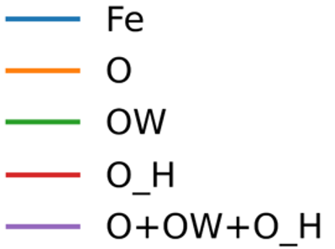
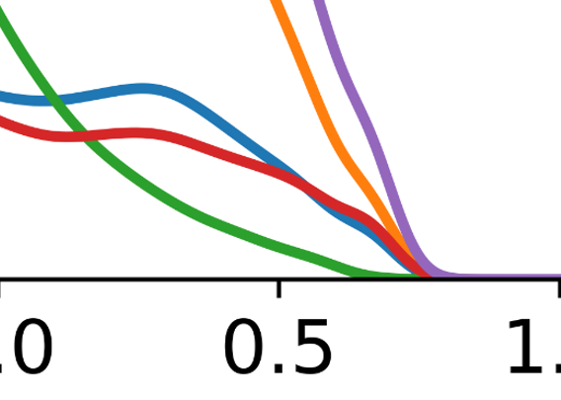
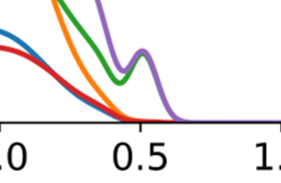
21/31
Cause and Effect of Hole Localization in Hematite-Water Slab
Electronic Structure Correlation with Hole Localization: From PDOS:
•Hole on hematite → HOMO has greater contributions from O(hematite) • Hole on water → HOMO has greater contributions from O(water)
From HOMO–LUMO energies:
• Hole on hematite → Higher average HOMO/LUMO energies • Hole on water → Lower average HOMO/LUMO energies
Hole localization alters orbital alignment
Hole (hematite)
Hole (Water)
Hole (hematite)
Hole (Water)
Structural Changes Not a Factor: • No significant differences in water structure, OH bonds, or hydrogen bonding. • Localization shifts not driven by geometry.
Role of Internal Fields: • Hole localization can be modulated by internal electric fields. • Mimics effects seen under external field simulations.

Slide 22
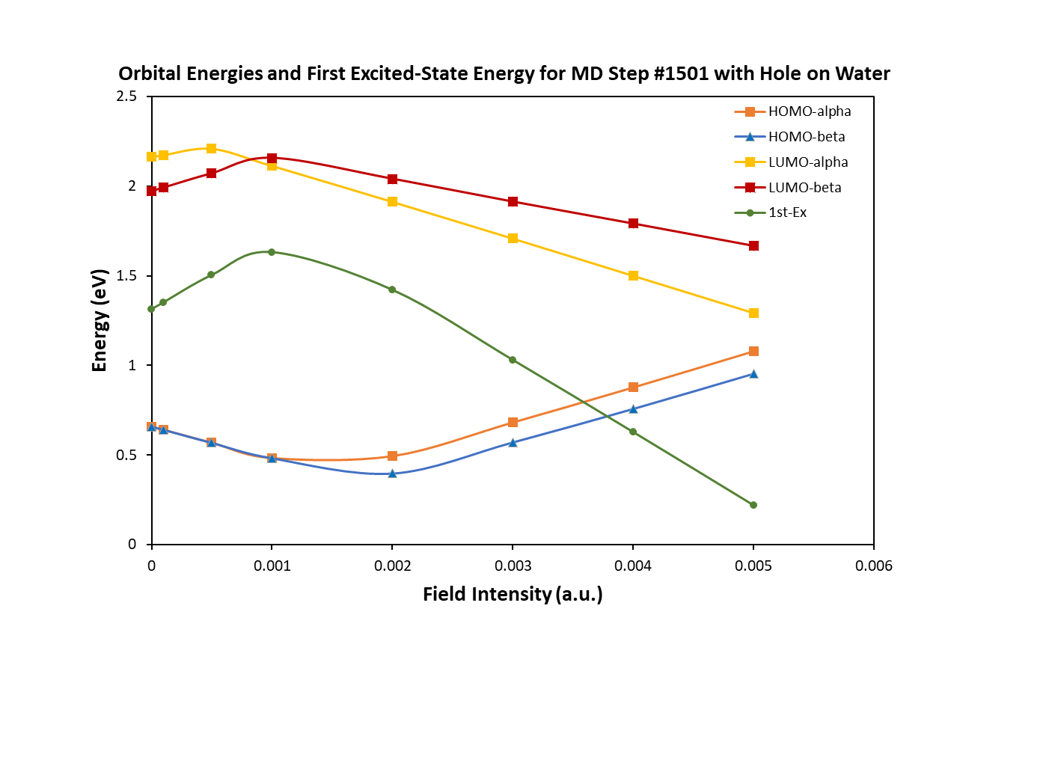
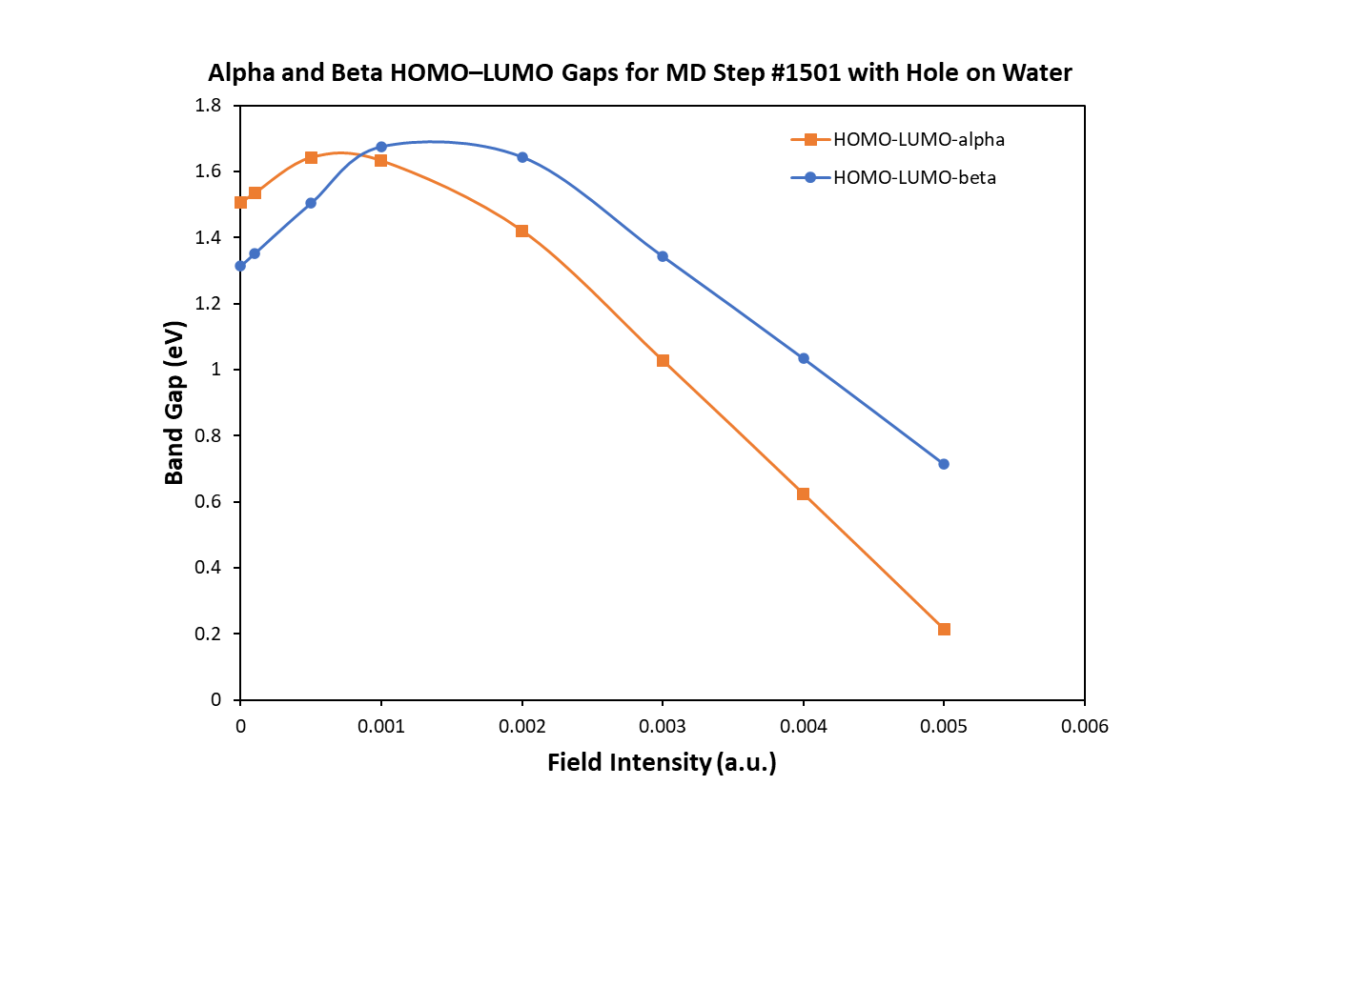
22/31
Mimicking Internal Electric Fields to Understand Exciton Behavior
Effect of internal field:
No significant change in plane-averaged electrostatic potential
Internal field estimation from these results remains challenging
External Field:
Applied +z field mimics interfacial effects
Captures HOMO/LUMO shifts, excitation energies, and e–h localization
HOMO sensitivity:
HOMO energy shifts with field strength
Localization trends:
Hole relocates across basal planes or between hematite and water with increasing field

Slide 23
Conclusion II
Exciton in Hematite–Water Slab Systems

Slide 24
24/31
Conclusion II: Exciton in Hematite–Water Slab Systems
Excitation mainly originate from hematite, with fewer from water.
HOMO–LUMO levels and orbital contributions vary with hole localization.
Atomic structure remains largely unchanged regardless of hole position.
Hole localization is influenced by interfacial electric fields, mimicked by an applied external field.

Slide 25
OUTLOOK
outlook

Slide 26
26/31
Outlook
Validated Approach
Apply to Other Oxides
Explore Solid-Liquid Interfaces
Design Better Materials
Combined DFT–TD-DFT–NA-MD successfully captures exciton structure and dynamics in a high-spin d⁵ anti-ferromagnetic configuration.
Test this computational protocol on d⁰ oxides (TiO₂) and d¹⁰ oxides (Cu-based) to assess method robustness.
Extend NA-MD approach to solid-liquid systems to investigate how interfaces impact exciton lifetimes and recombination dynamics.
Use insights to guide investigation of next-generation semiconductors with improved charge transport for solar energy conversion.

Slide 27
My Research Impact
Publications, Presentations, and Awards

Slide 28
28/31
My Research Impact: Publications, Presentations, and Award
Peer-Reviewed Publications
Rassouli, L.; Dupuis, M. Electronic Structure of Excitons in Hematite Fe₂O₃. J. Phys. Chem. C 2024, 128, 743–758.
Rassouli, L.; Shakiba, M.; Akimov, A. V.; Ma, X.; Dupuis, M. Excitons in Hematite Fe₂O₃: Short-Time Dynamics from TD-DFT and Non-Adiabatic Dynamics Theories. J. Phys. Chem. C 2024, 128, 13681-13693.
Manuscripts
Johnston, C. R.; Speelman, R.; Arcidiacono, A.; Bridgewater, C.; Rassouli, L.; Ma, X.; Vargas-Hurlston, I.; Kupferberg, J.; Martin, L.; Martinson, A. B. F.; Dupuis, M.; Geiger, F. M.; King, S. B. Watching Polarons Dance: Coherent Carrier-Phonon Coupling in Hematite Revealed by Transient Absorption Spectroscopy. Submitted to J. Am. Chem. Soc.
Rassouli, L.; Rosso, K.; Dupuis, M. Electronic Structure of Excitons in Hematite-Water Slab, In preparation for J. Phys. Chem. C.
Poster Presentations
Molecular Quantum Mechanics (MQM) Conference, Virginia Tech, June 2022.
ACS Northeast Regional Meeting (NERM), October 2022.
DOE Office of Science Graduate Student Research (SCGSR) Fellowship, Summer 2024
Selected as one of 87 graduate students nationwide to conduct research at Pacific Northwest National Laboratory as part of this prestigious U.S. Department of Energy program.

Slide 29
Acknowledgments

Slide 30

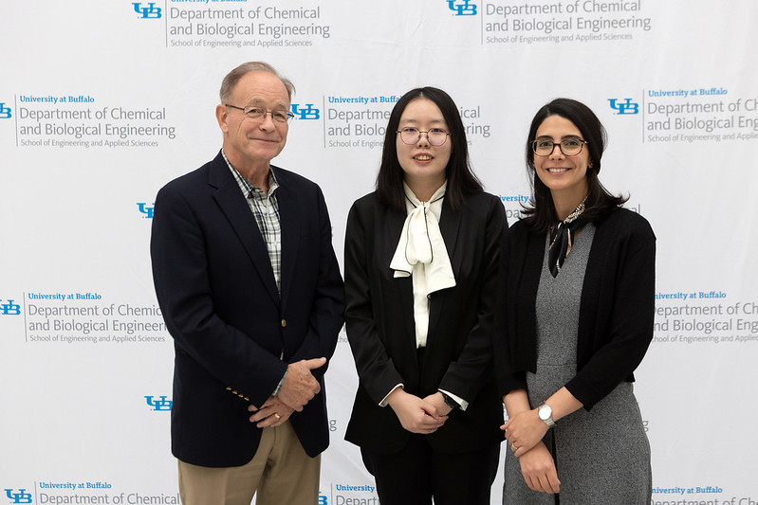

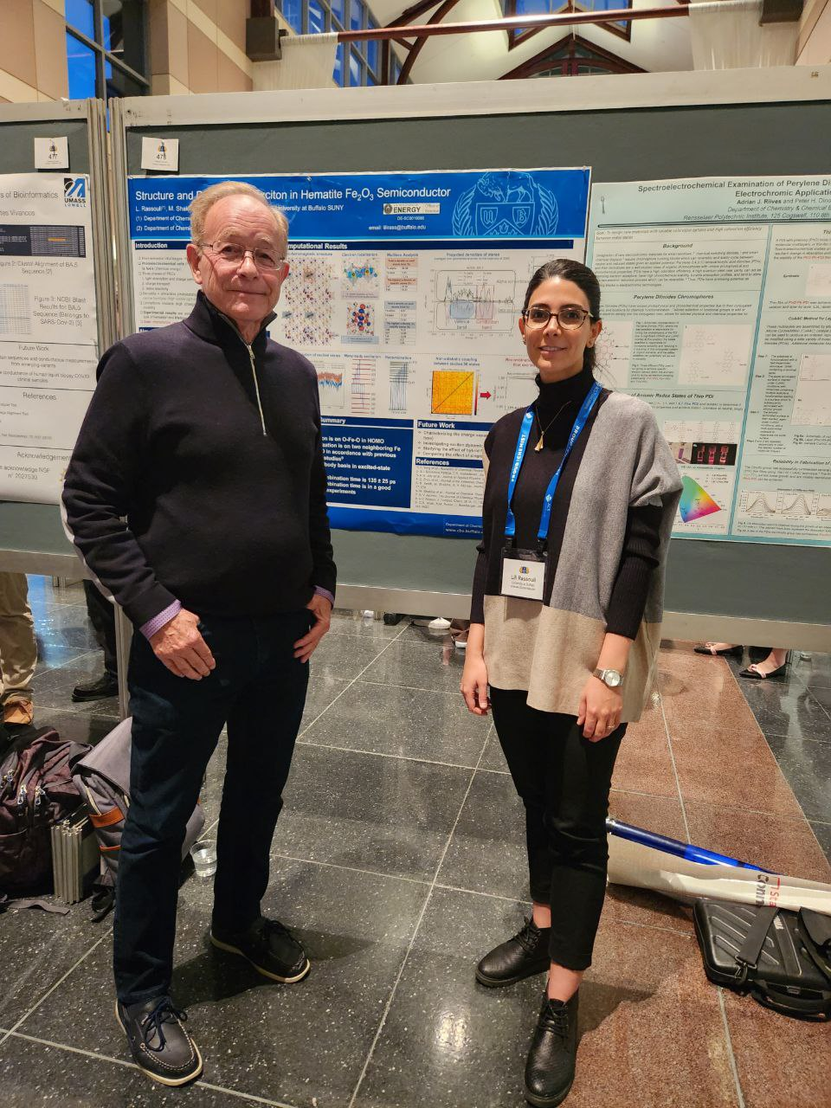




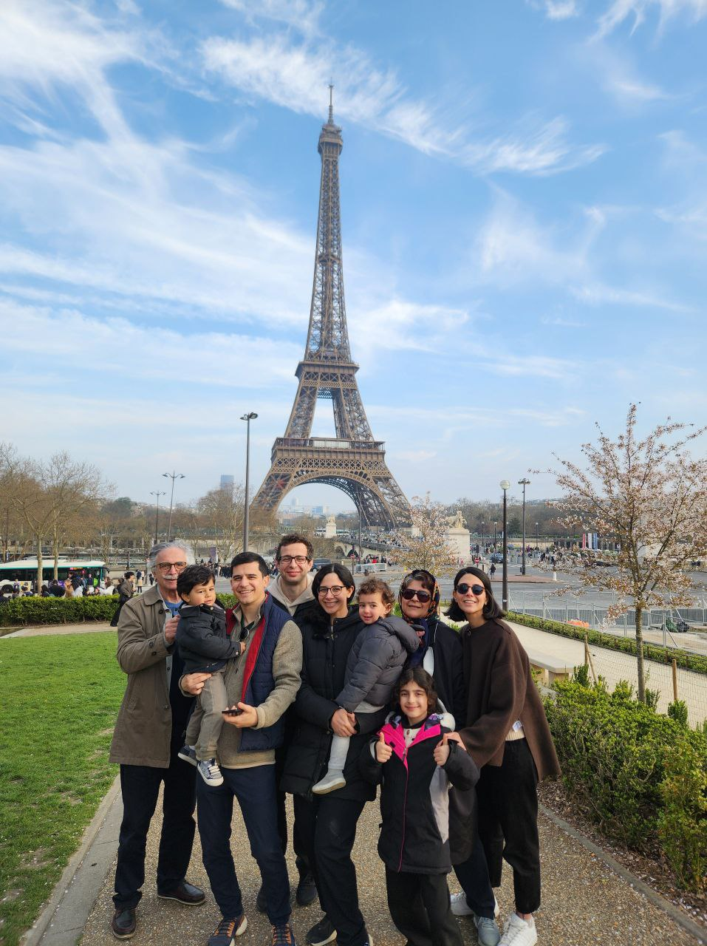


30/31
Acknowledgments
Prof. Michel Dupuis – For his exceptional mentorship, encouragement, and trust throughout my Ph.D. journey, and for guiding me into the world of computational chemistry.
Dr. Kevin Rosso & the PNNL team – For their support, scientific guidance, and continued mentorship.
Dr. Alexey Akimov – For inspiring teaching and critical mentorship during collaborations.
Colleagues & Friends – Especially Mohammad Shakiba and Xuyan Ma, for their support, generosity, and friendship.
Thesis Committee – Prof. Johannes Hachmann, Prof. David Kofke, and Dr. Alexey Akimov for their thoughtful feedback and guidance.
My Family – Deepest gratitude to my parents, sister, and especially my husband Yousef and our son Nami for their unwavering love and support.

Slide 31

Thank You
Email Address:
Lilirass@buffalo.edu
Contact Number:
585-705-1136

Slide 32
Supplemental Slides

Slide 33
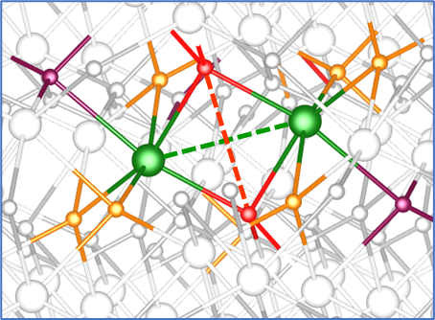
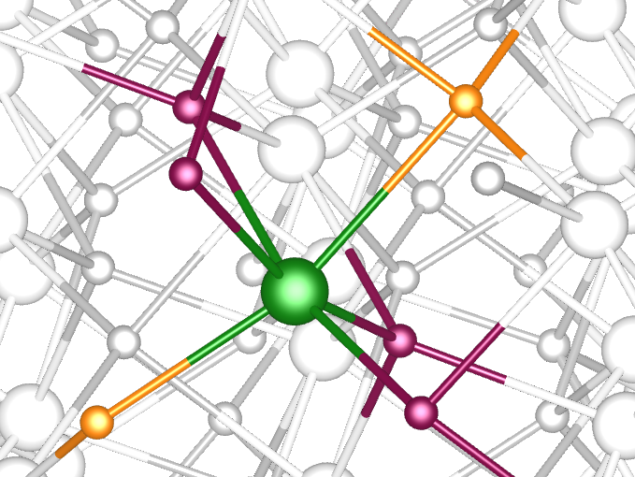
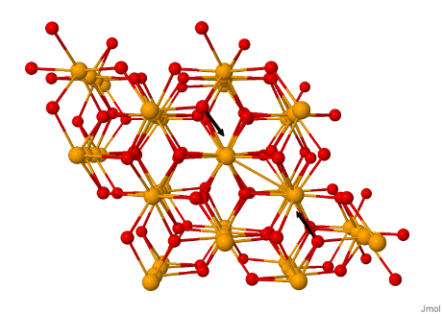

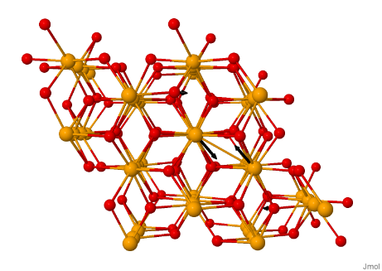
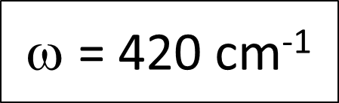


Generalized Subsystem Vibrational Analysis
LUMO (electron site): → Symmetric Fe–O stretch: ~420 cm⁻¹ → Full system: 431 cm⁻¹ → Asymmetric stretch: ~334 cm⁻¹ → Full system: 473 cm⁻¹ → Fe–Fe stretch: ~189 cm⁻¹ → Full system: 163 cm⁻¹
4-cluster LUMO site
HOMO (hole site): → Fe–O stretch cluster modes: ~230, 320, 420, 479 cm⁻¹ → Mapped to full system: ~339, 414, 516, 576 cm⁻¹
5-cluster HOMO site

Slide 34


34/31
Hole Localization and Optical Transitions across 150 Excited States
Across 150 excited states from 30 MD snapshots (221-single):
hole localization favors O(hematite) (dominant in 43% of snapshots, exclusive in 37%)
Only 20% of snapshots show O(water) as the main hole localization site
Applying an oscillator strength filter (>1×10⁻⁶):
significantly reduces water-localized hole states, indicating that O(water) holes are mostly in weakly absorbing excitations
O(hematite) holes are more prevalent in optically active transitions
Summary of key points:
Higher hole localization on O(hematite) than O(water); more frequent
Hematite-localized hole states show stronger oscillator strengths → more optically active

